Slide 1
Wi-Fi automation lab Day 1 presentations
Andreas Koksrud / Telenor Bedrift
Co-authors:
Kjetil Teigen Hansen & François Vergès

Slide 2
References / inspiration
References
https://github.com/CiscoDevNet/yangsuite/
https://postman.com
https://docs.ansible.com/ansible/latest/collections/cisco/ios/ios_facts_module.html
https://www.wifireference.com/2020/01/14/viewing-network-telemetry-from-the-catalyst-9800-with-grafana/
https://grafana.com/grafana/dashboards/13462-device-health-monitoring/
https://grafana.com/grafana/dashboards/12468-catalyst-9800-client-stats/
https://wirelessisfun.wordpress.com/2020/12/10/network-telemetry-data-and-grafana-part-1-the-advanced-netconf-explorer/
https://python.org
https://codeium.com
https://canonical.com/multipass
https://blog.apnic.net/

Slide 3
Copyright
Copyright
© Andreas Koksrud 2025. All rights reserved. This presentation is provided for educational and informational purposes only. You may distribute and learn from this presentation, but commercial use or any form of monetization is strictly prohibited without prior written consent
Any slides marked Kjetil Teigen Hansen or the Conscia logo will also have full or co-ownership by Kjetil
Any slides marked François Vergès or the SemFio logo will also have full or co-ownership by François

Slide 4
Prerequisites
Communications
Cisco Meraki account (https://dashboard.meraki.com)
Juniper MIST account (https://manage.mist.com)
Postman account (https://postman.com)
Complete the pre-lab exercises (this document) before the deep dive labs
Bring an Ethernet dongle if you don't have built-in port
(optional) Bring an extra screen to show lab guide (or prepare to Alt-Tab)

Slide 5

Communications
Communications
WebEx space: Wi-Fi automation lab
Please help each other
Sharing is caring ☺

Slide 6
Agenda
Agenda
Pre-lab
Choose your hypervisor
Install Ubuntu Server w/Docker
Install Postman
Install VS Code
Day 1
Day 2
In-depth explore a topic of choice
Sort out pre-lab task problems
Grafana / TIG-stack
Grafana Cloud
Ansible
Python
Cloud vendor automation (MIST or Meraki)
Get to know the lab environment
Connect VS Code to Ubuntu
Install and explore Ansible
Explore Python automation
Install and explore YANG Suite
Explore Postman
Install and explore Grafana
(optional) install 9800-CL

Slide 7
Agenda - About Day 2 choices...
Agenda
Choose a track Horiontal - A taste of everything (try to cut at 45min for each) Vertical - 3h deep dive into one of the topics
Ansible
Run a CLI command
CLI configuration
Using Jinja2 templates
Using RESTCONF
Write your own module
Python
Grafana
Using Netmiko
RESTCONF + own module
Organizing projects
… more to come
Using RESTCONF
Get metrics, draw a graph
Working with AI companions
Using .env files
Nornir automation framework
More Nornir
… more to come
Working with syslog
Finish building your own TIG stack from day 1
Extended C9800 dashboard
… building more
… and improving even more
Cloud APs
MIST or Meraki
Use APIs with Postman
Use APIs with Python
Grafana Dashboard for Cloud APs

Slide 8
Scope
Scope
In scope
Getting started with various systems/languages/solutions for lab purposes
Set up your own Ubuntu Linux server on your own laptop. It will be possible to use a shared server if you do not want or have possibility to install an Ubuntu VM on your laptop
Some nice examples to try various aspects of automation
Inspiring you to explore deeper on your own
Out of scope topics
Git
Learning the languages (Ansible, Python, InfluxQL, etc)
Learning Linux
Deploying the systems for production use
Troubleshooting WLC/AP connection

Slide 9
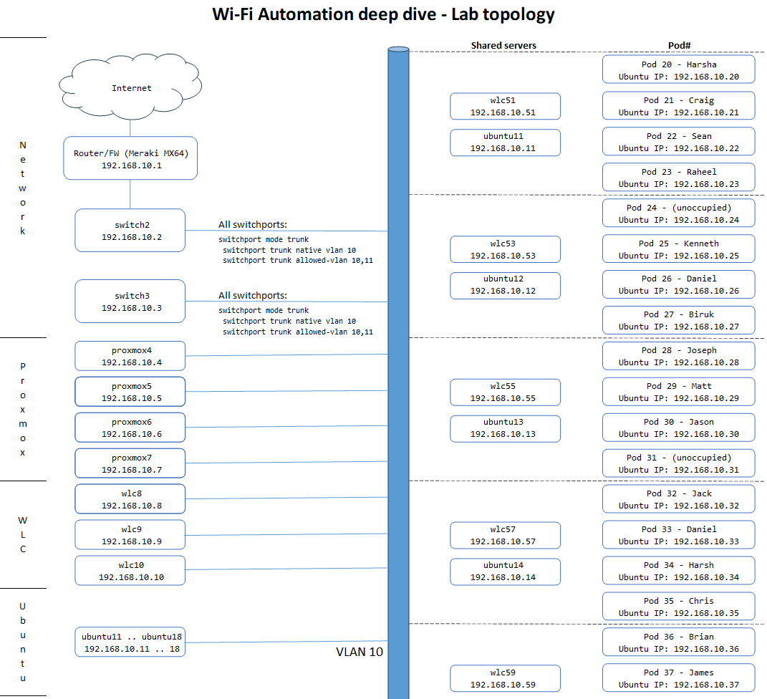

Lab topology
Each student have an assigned Pod number. When using static IP, their Ubuntu Server should have the same last octet as the Pod#
2 students share a preconfigured WLC, as assigned in the topology map
Everyone is connected to VLAN 10
All switchports on all switches are trunk ports with VLAN 10 as native, and allowed vlan as VLAN 10 and 11
For Wi-Fi clients on your SSIDs you can use VLAN 11 to not fill up VLAN 10

Slide 10
Automation in the Wi-Fi lifecycle
Automation in the Wi-Fi lifecycle
Some examples of automation in different phases
Prepare
Python scipt for information gathering / network mapping / device walking
Plan
Python script for large-number analysis of devices (and/or maybe Excel is better for parts of it)
Design
Prepare data to use in the Implement phase
Implement
Python script for creating IP pools, or creating site hierarcy etc in DNAC
Ansible and/or some vendor specific Zero-Touch provisioning variants for device config based on some source of truth
Operate
Write Python scripts for changes that involve large number of devices
Ansible for repeating tasks
Grafana for real-time troubleshooting
Optimize
Grafana for monitoring/graphing/analysis
Python scripts or Ansible playbooks to analyze possible optimizations (APs on 100Mbit, hostnames of neighbors that differ, etc)

Slide 11
VirtualBox - Type 1 vs Type 2 hypervisors
Hypervisors
Type 1
Bare-metal (run directly on hardware)
Superior performance
Type 2
On top of another OS
For production use
Examples
VMWare ESXi
Proxmox
KVM
Xen
Nutanix
Flexible, can run on your laptop
For lab purposes or at least non-24/7
Examples
VirtualBox
VMWare Workstation
Parallels
Hyper-V

Slide 12
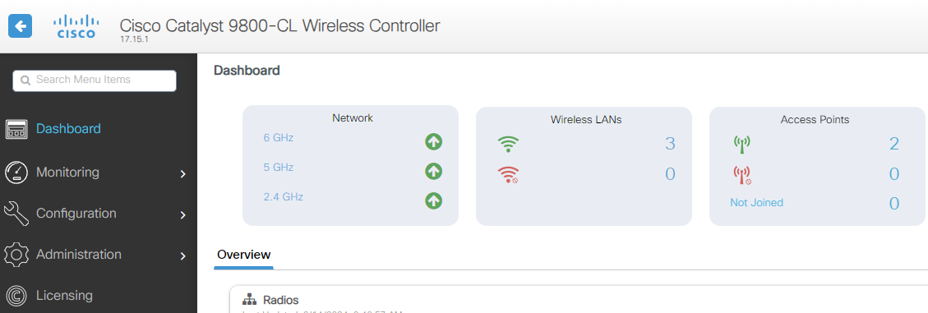
WLAN Controllers
WLAN Controllers
This lab use Cisco 9800-CL WLC
Project the knowledge to your platform of choice
Other vendors WLAN Controllers or similar concepts
Cloud-managed solutions often have good APIs
Ansible, Python, etc have lots of collections

Slide 13

Ubuntu Server
Ubuntu Server
This lab use Ubuntu Server
Most stuff can be done directly on your own laptop
Currently Ansible can not run directly on Windows
TIG stack ... maybe(?)
I like to play with stuff using a server, I find it easier to transfer to live systems
WSL (Windows Subsystem for Linux) is a very good alternative for Python and Ansible. For Grafana it might be more tinkering

Slide 14
Docker
Docker
This lab use Docker as the container platform
Pre-made packages for TIG stack and YANG Suite
Could just as well be using Kubernetes etc

Slide 15
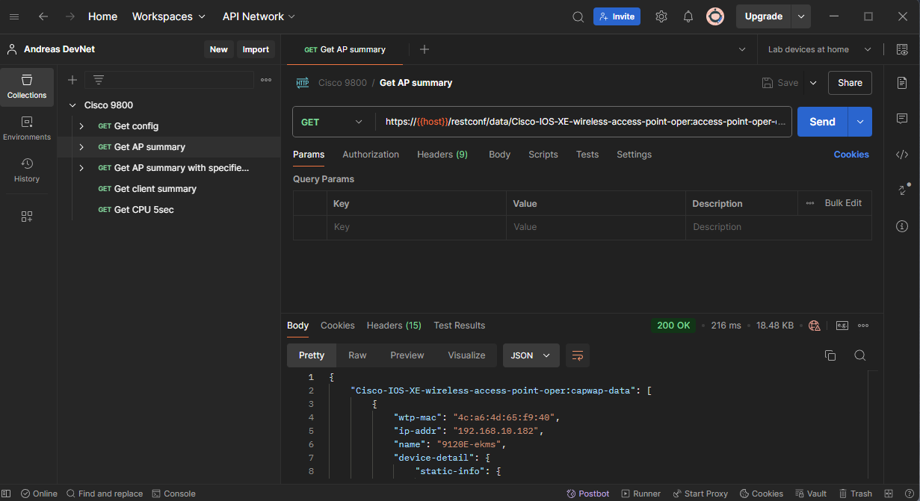
Postman
Postman
Postman is a "go-to" tool for RESTCONF APIs. Some examples for automation are
Exploring RESTCONF calls
Checking the datastructure you get in return
Validating the calls to devices before implementing in Python, Ansible, etc
Get example code in your preferred language for that specific RESTCONF call

Slide 16
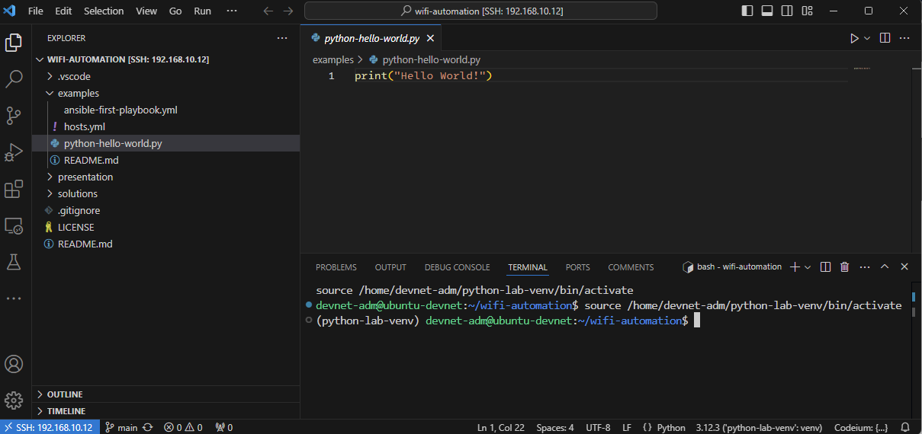
VS Code
VS Code
This lab use VS Code as text editor / development environment
Some other popular alternatives for all or parts of the process
VS Codium
Atom
Notepad++
Jupyter Notebook
Anaconda ecosystem

Slide 17
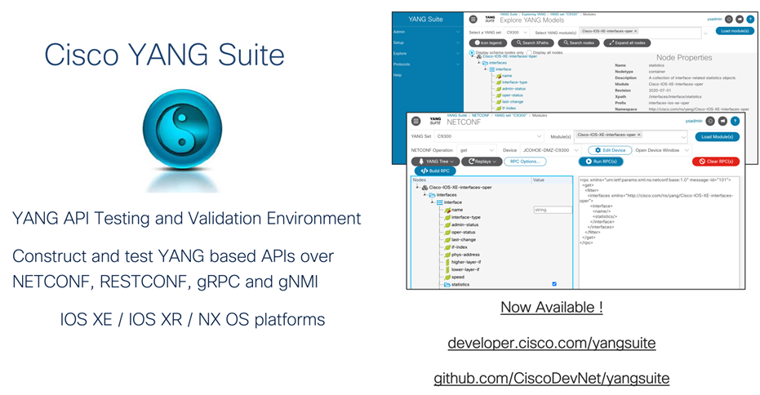
YANG Suite
YANG Suite
Testing and validation environment for YANG related tasks
Install as a docker container
We will use this to explore the world of YANG models present in the Cisco 9800 WLC

Slide 18




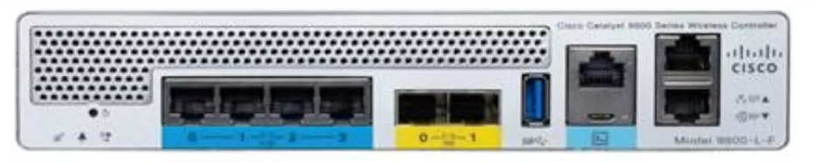

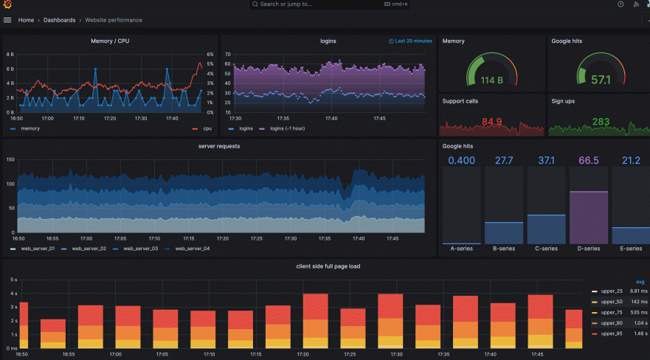



TIG Stack
TIG Stack
Bla bla about what is TIG stack
gRPC / TCP 57000
C9800
metrics goes to the database
Wow!
TCP 8086
Grafana to visualize
WebUI – server:3000
TCP 3000

Slide 19
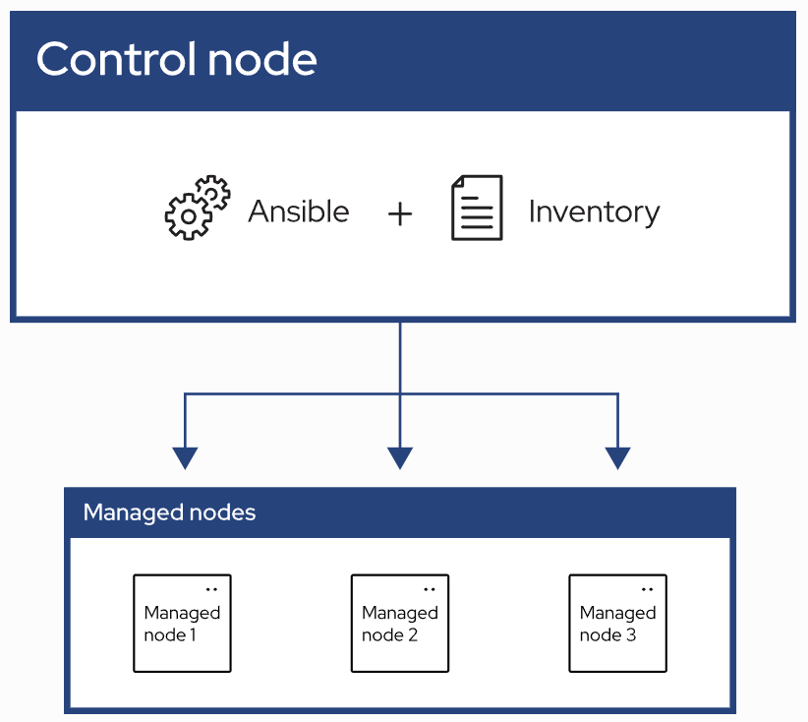
Ansible
Ansible
Automation using "playbooks" written in YAML format
Agent-less architecture
No installation on the managed nodes
Idempotency
Does not change/write if target is already in state described by playbook
Control node
System where Ansible is installed and runs the playbooks
Inventory
List of managed nodes where the playbook will affect
Managed nodes
Remote systems that are the targets of your playbooks

Slide 20
Pod numbers
Pod numbers
Students get pod numbers ranging from 20 and up
4 pods share 1 WLC and 1 preinstalled Ubuntu server

Slide 21
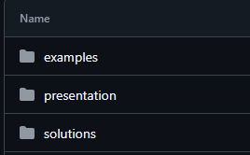
Material on github
Github
Everything can be downloaded from
https://github.com/akoksrud/wifi-automation
Some examples used in Day 1 tasks
All presentations (PPT and PDF)
Solutions for all exercises
PS C:\Users\akoksrud> git clone https://github.com/akoksrud/wifi-automation
Cloning into 'wifi-automation'...
remote: Enumerating objects: 311, done.
remote: Counting objects: 100% (72/72), done.
remote: Compressing objects: 100% (55/55), done.
remote: Total 311 (delta 34), reused 53 (delta 15), pack-reused 239 (from 1)
Receiving objects: 100% (311/311), 43.05 MiB | 34.74 MiB/s, done.
Resolving deltas: 100% (140/140), done.
PS C:\Users\akoksrud> cd wifi-automation
PS C:\Users\akoksrud> code .

